Slide 1
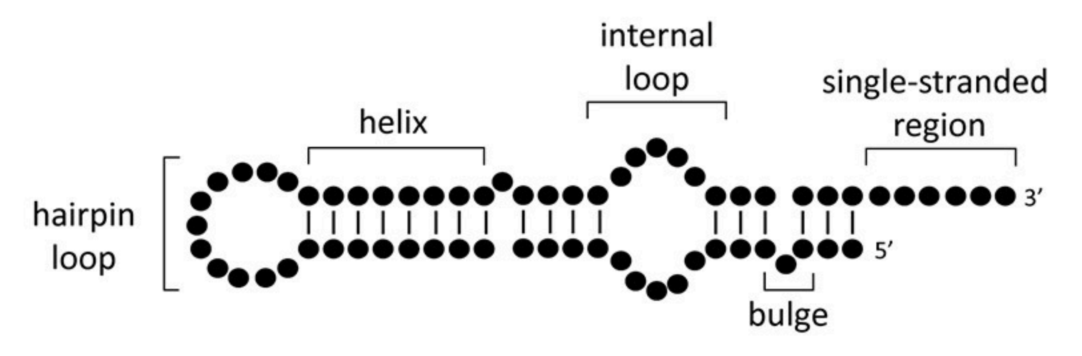
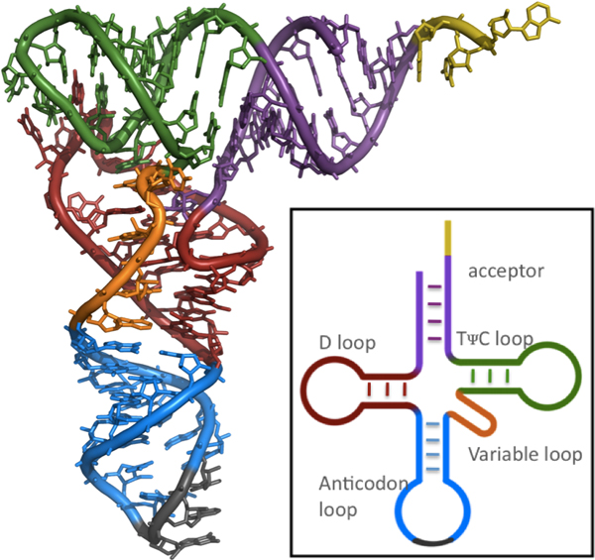
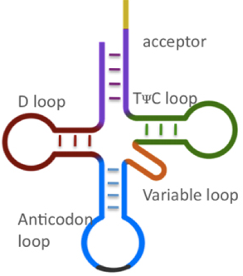
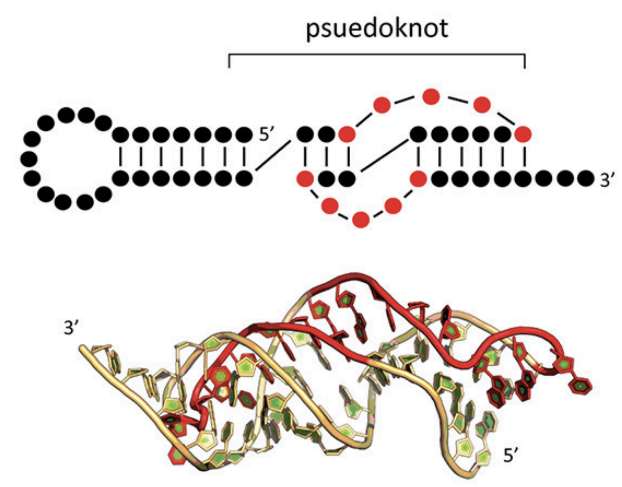
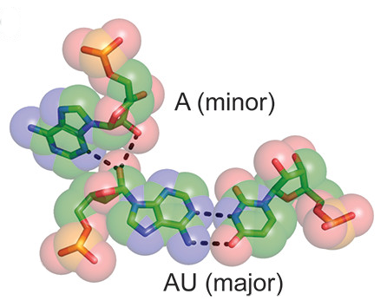
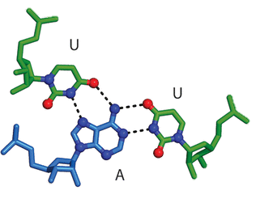
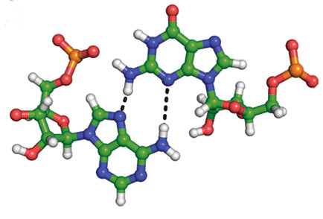
A
B
C
D
A-minor interaction
Base triple pair
Non-canonical base pair
Notes:
A. https://www.researchgate.net/figure/Common-secondary-and-tertiary-motifs-of-RNA-and-RNA-conformational-changes-in-RNP_fig1_322936039
C. https://pubs.acs.org/doi/10.1021/ar200098t
D. https://www.researchgate.net/figure/Common-secondary-and-tertiary-motifs-of-RNA-and-RNA-conformational-changes-in-RNP_fig1_322936039

Slide 2
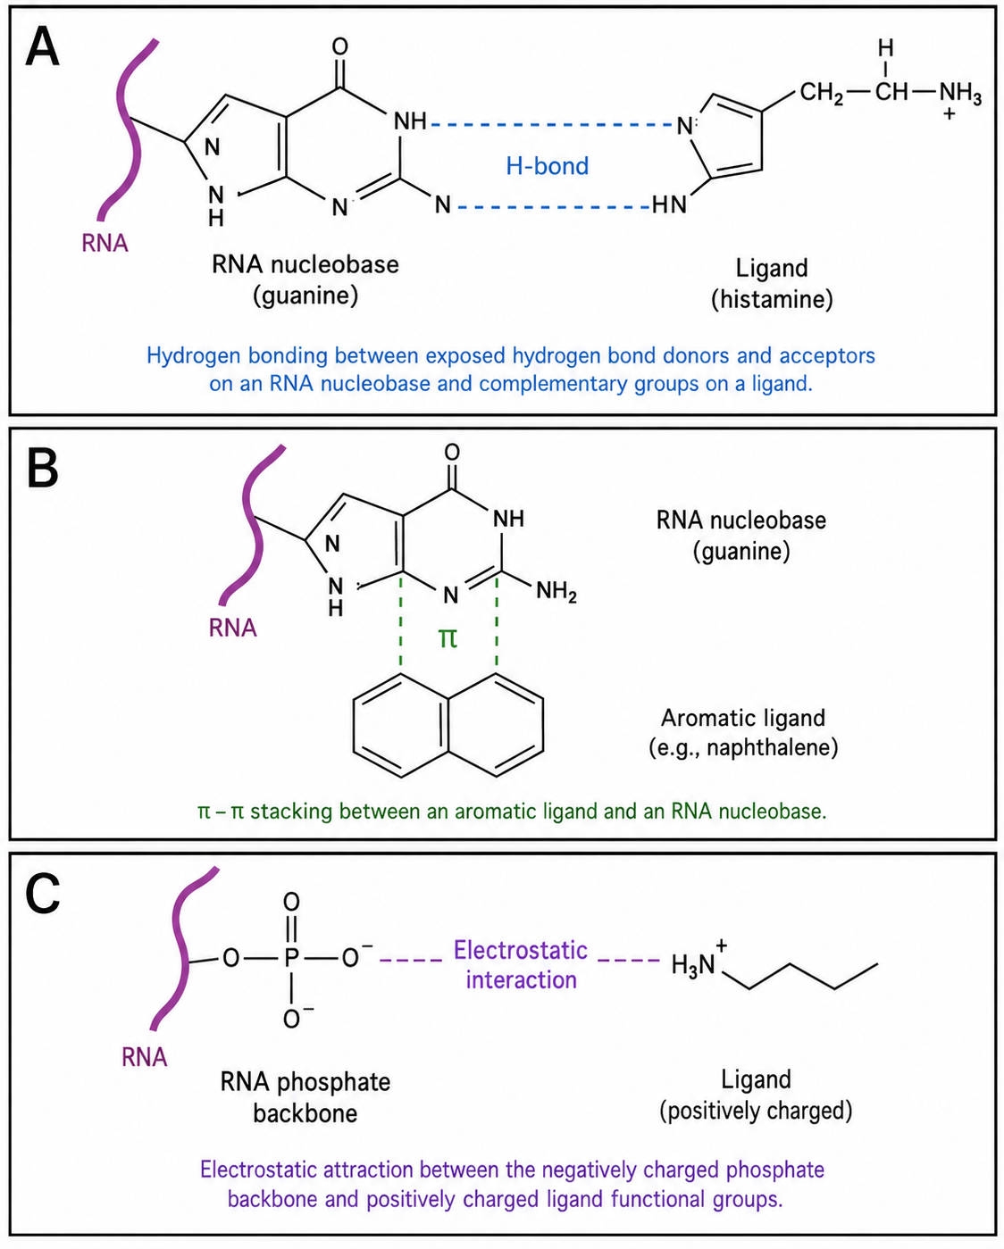
A
B
Aromatic ligand
(naphthalene)
C

Slide 3
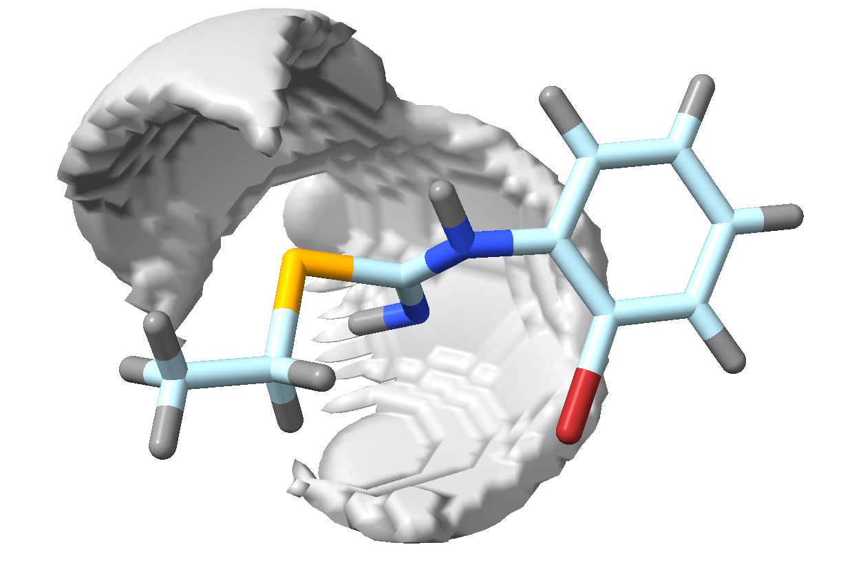
SMIF Input (.cmap)
Conditional Encoder
Concatenate $[z,c]$
Latent space
Decoder
Structure Input
(.pdb)
Generated Ligand Structure (.pdb)
Mean, $μ$
Input Encoder
Variance, $σ$

Slide 4
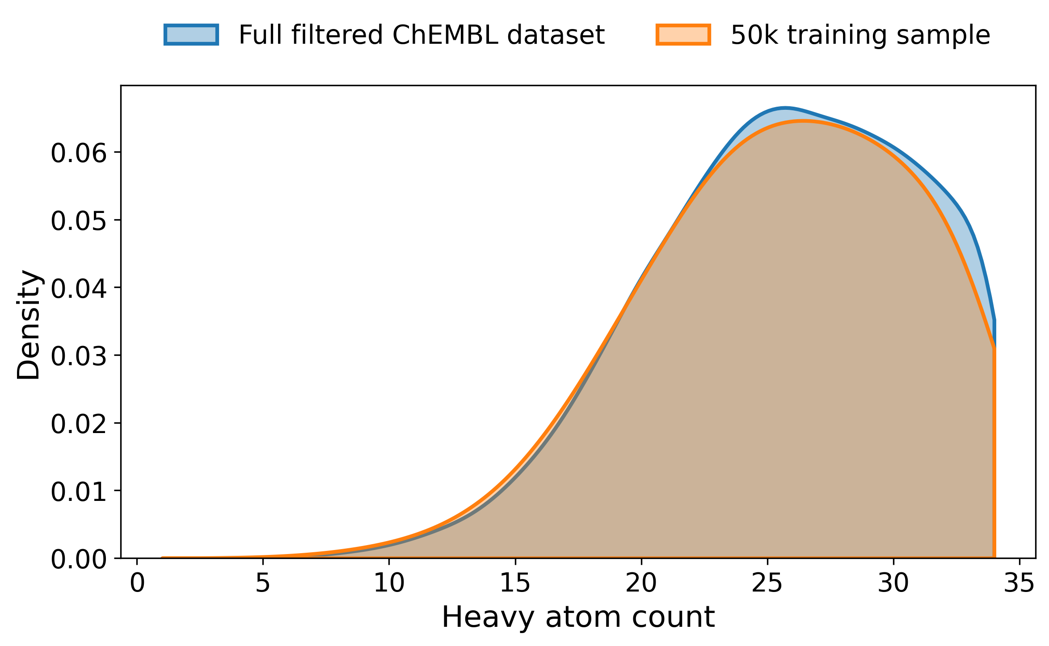
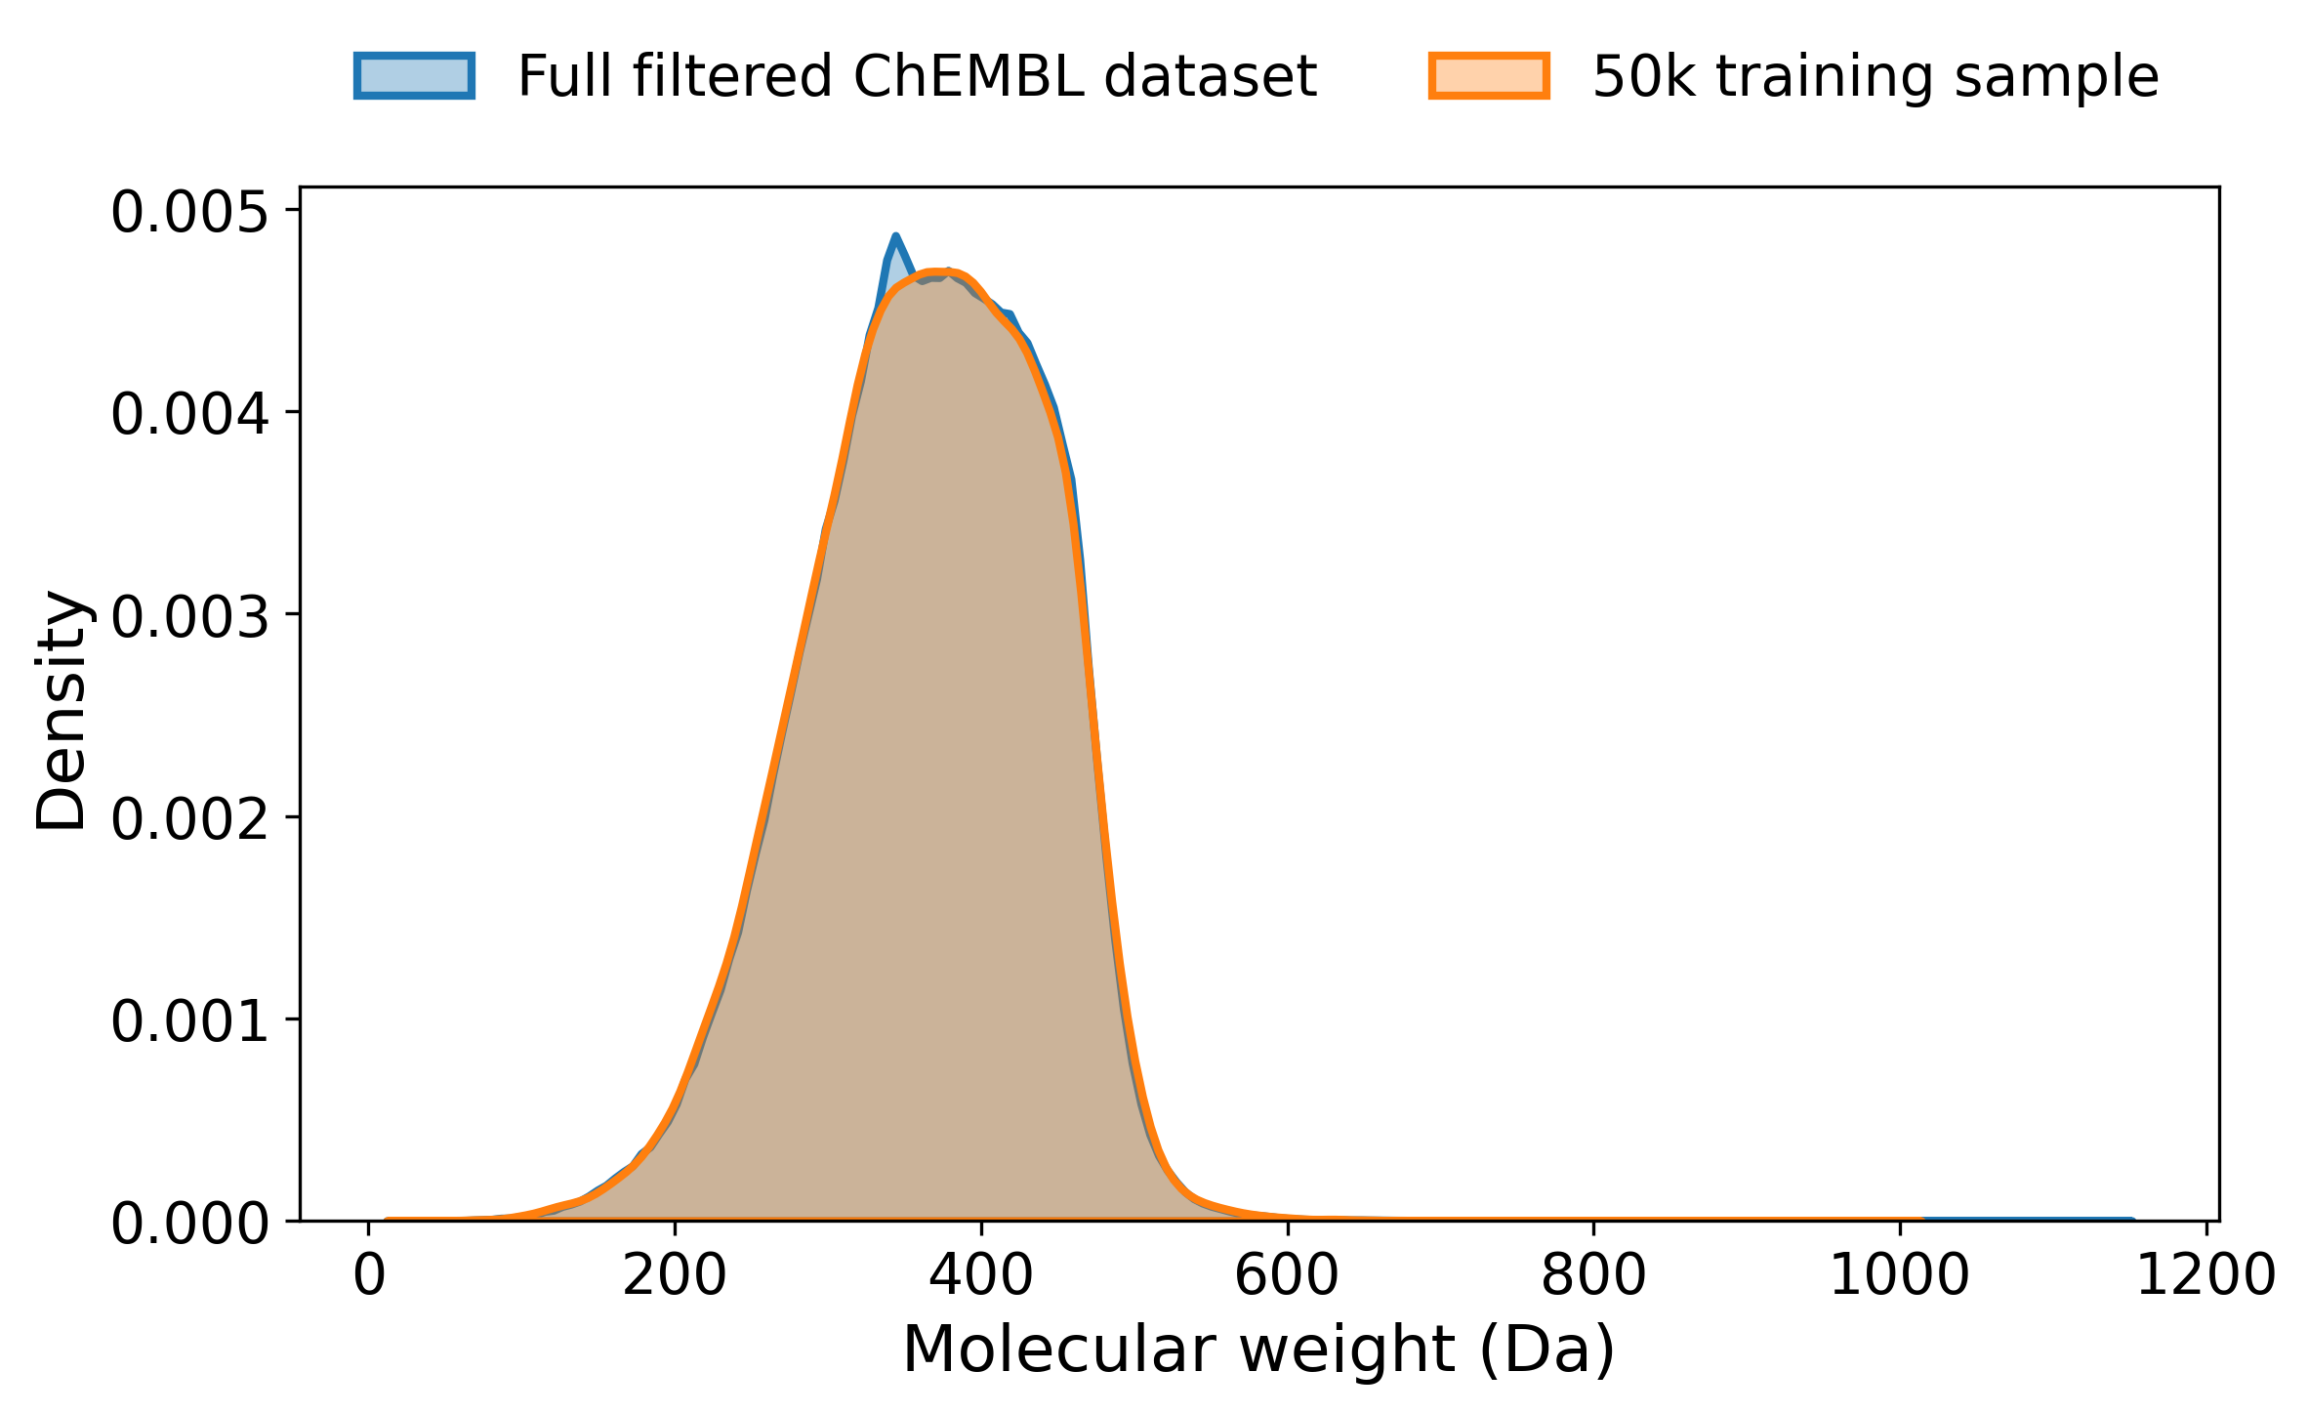
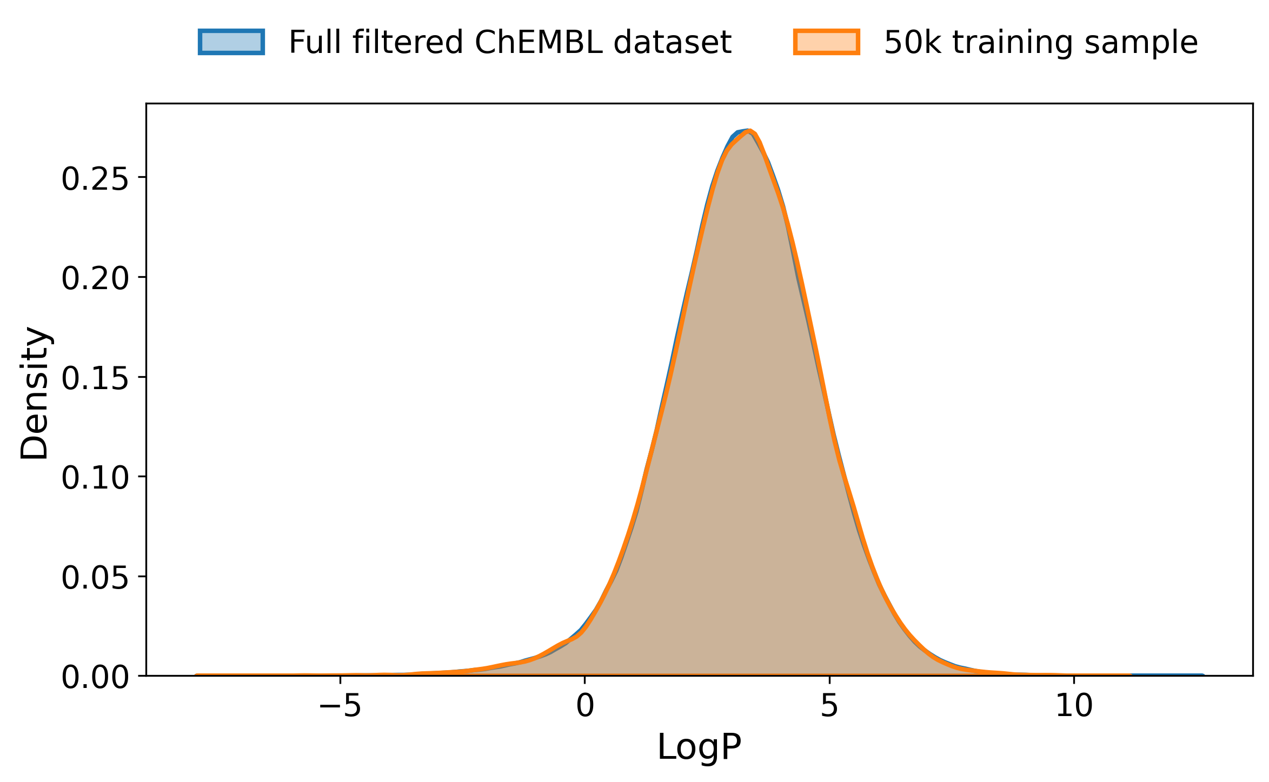
A
B
C
Notes:
To validate my pipeline, I first visualized simple molecules in ChimeraX and examined their interaction fields. In CO₂, the oxygen atoms act as H-bond acceptors, giving only acceptor regions. Urea shows both H-bond donor and acceptor regions, with the NH groups acting as donors and the carbonyl oxygen as an acceptor. The azide ion shows strong H-bond acceptor character across the terminal nitrogen atoms due to its negative charge. Finally, tetramethylammonium shows only hydrophilic regions due to its positively charged nitrogen, with no H-bond donor or acceptor features. Overall, these results confirm that the pipeline correctly captures basic chemical features.

Slide 5
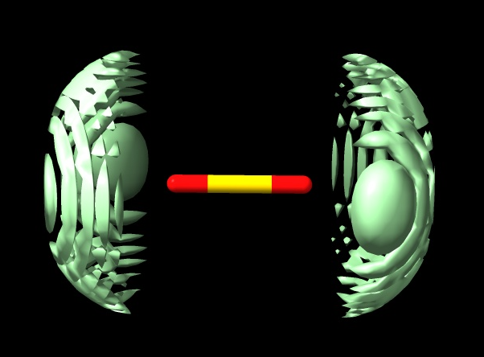
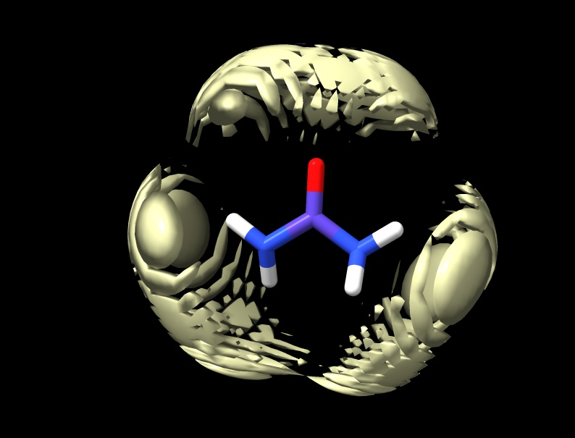
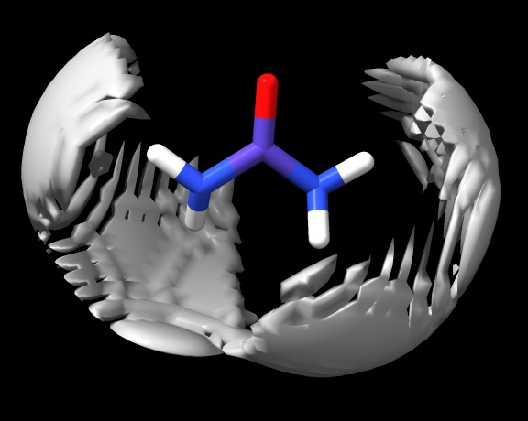
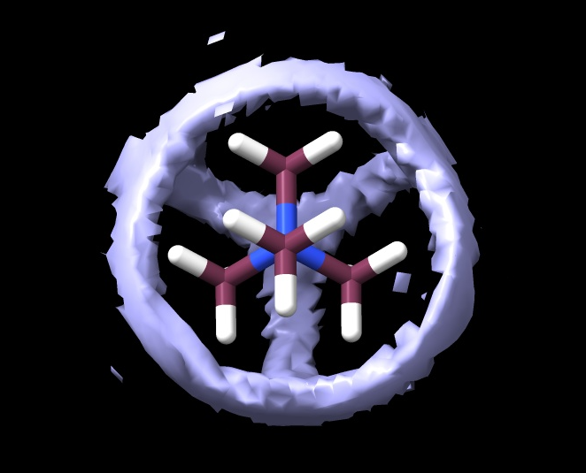
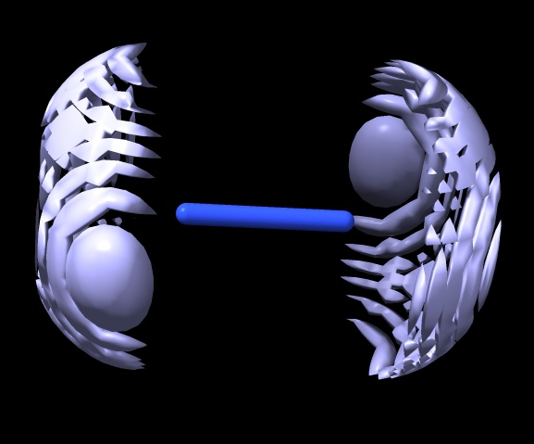
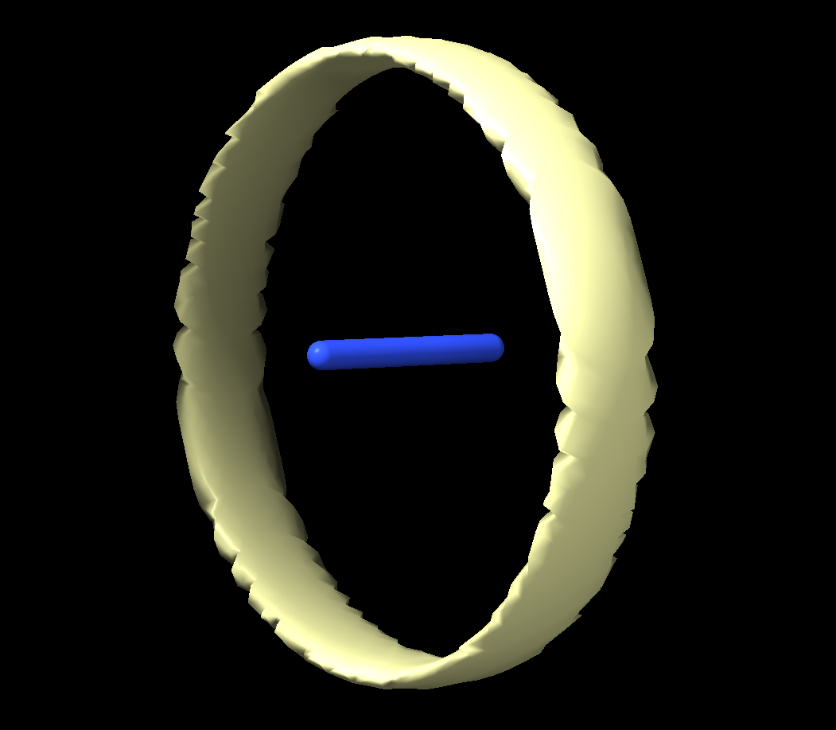
A
B
H-bond acceptors
H-bond acceptors
H-bond donors
C
D
Hydrophilicity
H-bond acceptors
Hydrophobicity

Slide 6
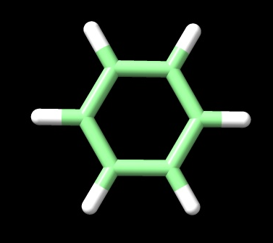
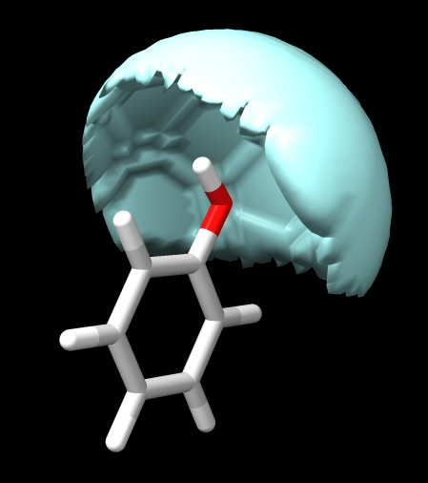
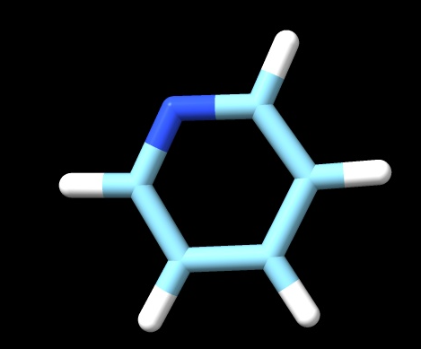
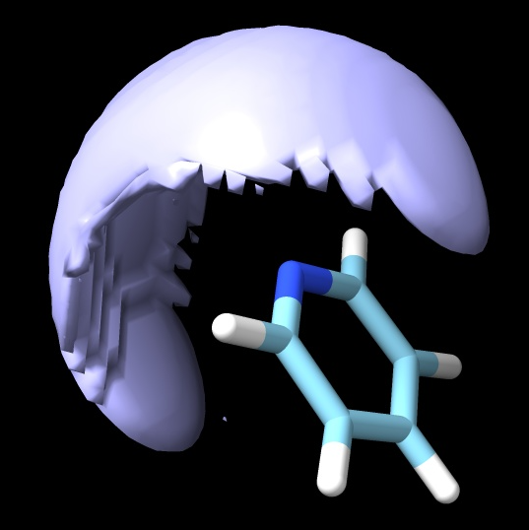
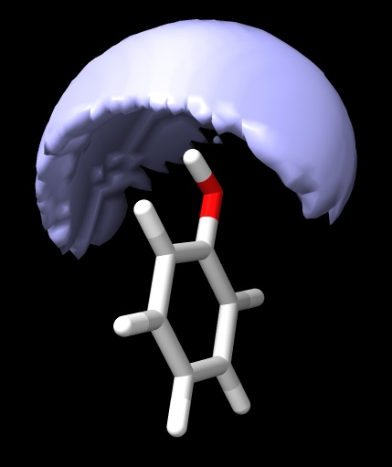
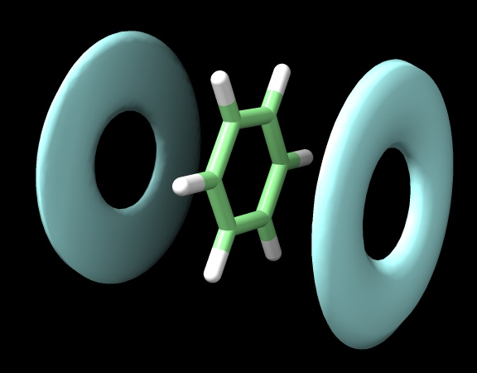
A
B
C
Notes:
Next, I looked at aromatic and planar molecules to check that the pipeline captures ring systems and functional groups correctly. Benzene shows clear aromatic stacking regions, which is what we’d expect from its delocalized π system. With phenol, we start to see hydrogen bonding — the OH group acts as both a donor via the hydrogen and an acceptor via the oxygen. Pyridine then introduces a nitrogen in the ring, and that’s correctly picked up as a hydrogen bond acceptor due to its lone pair. So overall, this shows the pipeline can handle aromaticity.

Slide 7
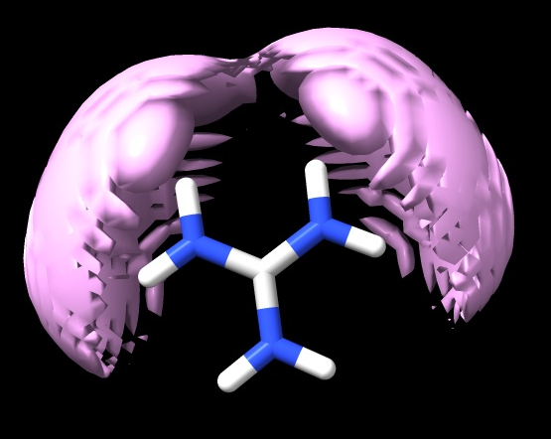
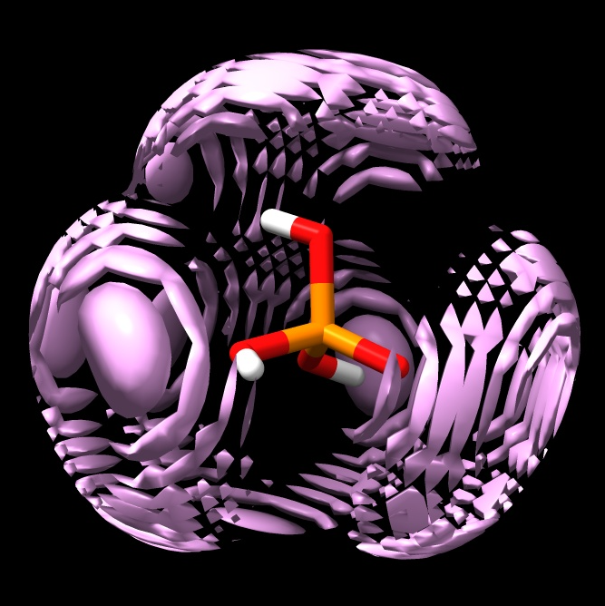
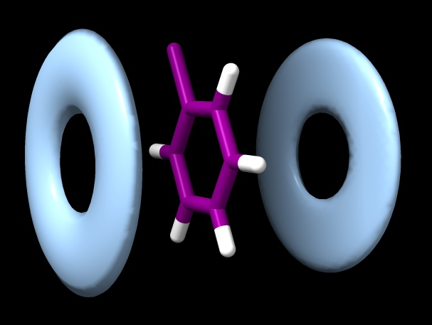
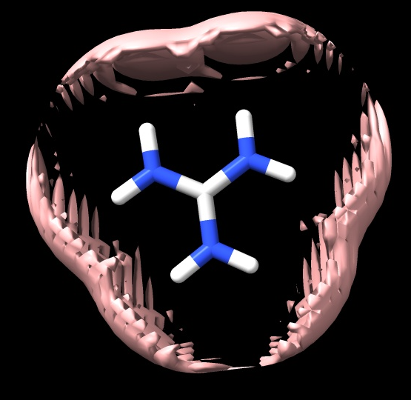
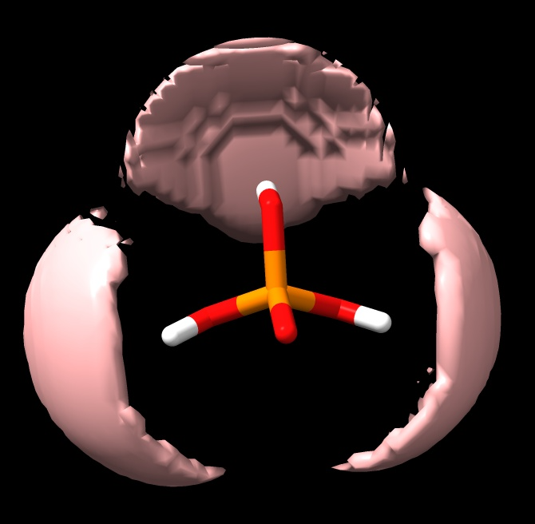
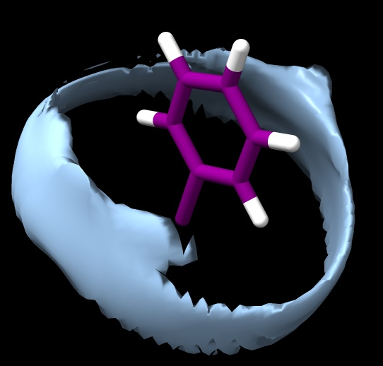
A
B
C
H-bond acceptors
H-bond acceptors
Stacking
H-bond donors
H-bond donors
Hydrophobicity
Notes:
I looked at more complex molecules with multiple functional groups. Guanidine contains a central carbon bonded to three nitrogen atoms. The hydrogen atoms attached directly to the nitrogen atoms act as the donors and the electronegative nitrogen atoms with lone pairs of electrons, particularly the imine-like nitrogen (=N-) and amine nitrogens (-NH2), act as acceptors.
Phosphoric acid has several hydroxyl groups acting as donors and a phosphoryl oxygen acting as an acceptor. In contrast, chlorobenzene contains a chlorine-substituted aromatic ring with mostly C–H bonds, so it shows primarily hydrophobic regions with some weak polar character from the chlorine atom.

Slide 8
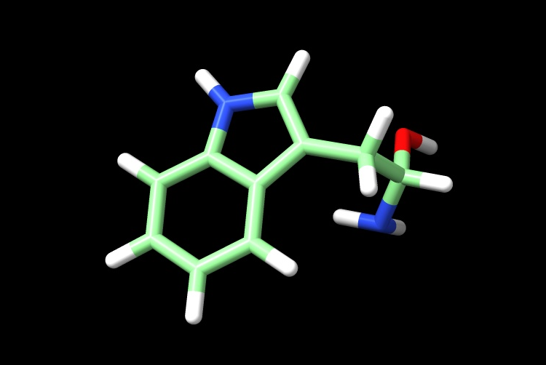
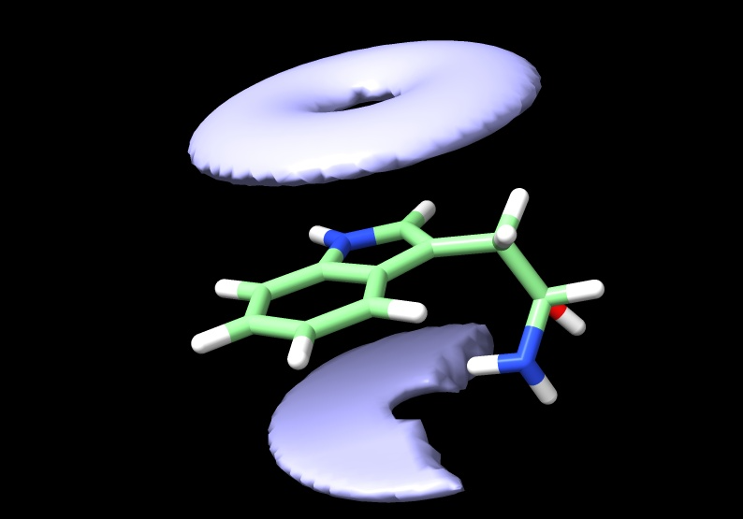
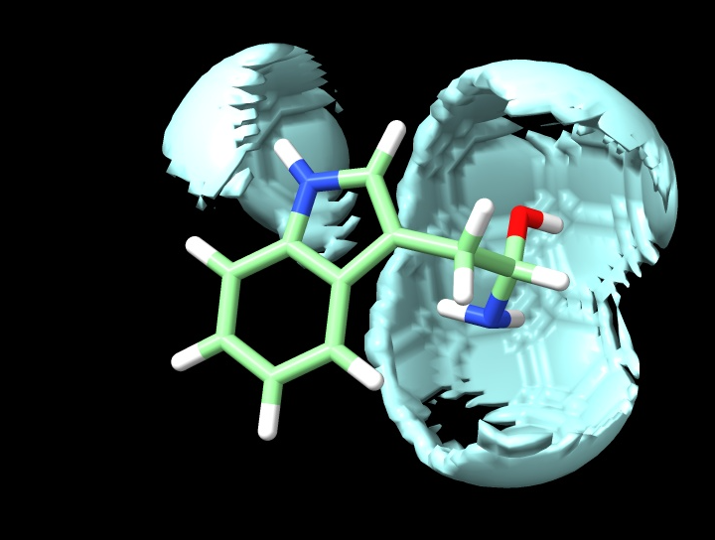
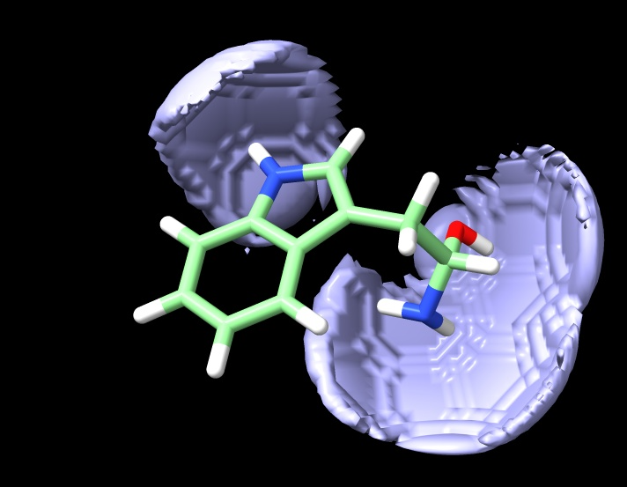
A
B
C
D
Notes:
Finally, I looked at L-tryptophan as a more realistic, drug-like molecule. It contains an indole aromatic ring, which shows clear stacking regions, as well as both hydrogen bond donors and acceptors from the amine and carboxyl groups. The pipeline captures all of these features within a single molecule. This demonstrates that it can handle molecules with mixed functionality, similar to those we expect in real ligand datasets.

Slide 9
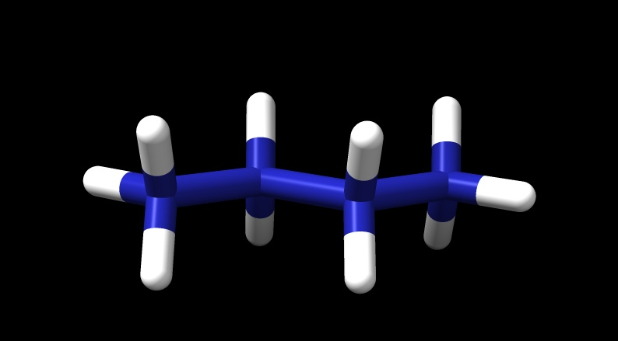
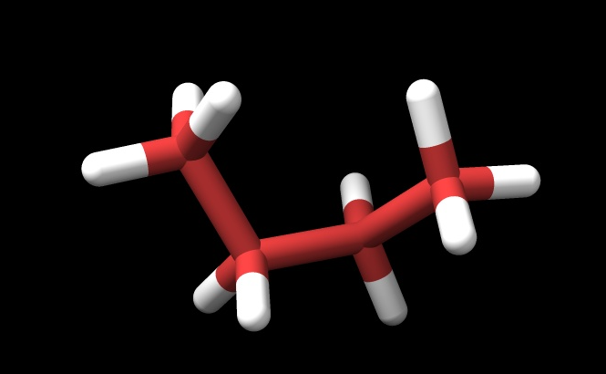
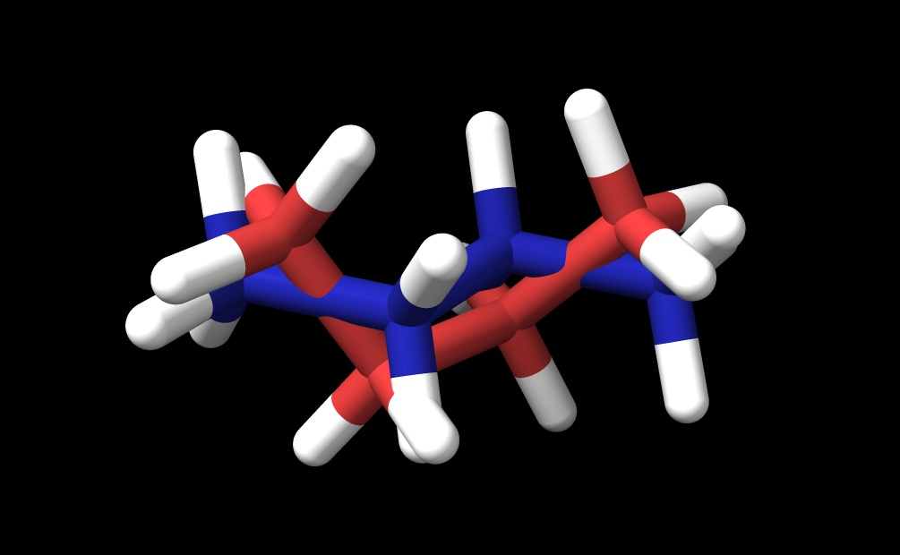
A
B
C
Notes:
To validate that the pipeline correctly captures 3D molecular geometry, I tested it on butane, which can adopt flexible conformations. I generated two conformers by controlling the central dihedral angle: the anti conformer (180°) and the gauche conformer (60°). After centering and aligning each conformer to its principal axes, I computed the bounding box. For the anti conformer, the largest extent is along X at 5.43 Å (angstrom), while Y and Z are smaller at 2.33 Å and 1.77 Å. The gauche conformer is slightly shorter along X at 5.14 Å but spreads more along Y and Z, 3.05 Å and 2.81 Å, reflecting its bent shape. The overlapped image visually highlights these differences, confirming that the bounding box calculation is sensitive to conformational changes.

Slide 10
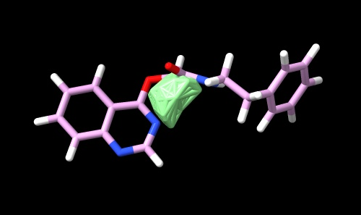
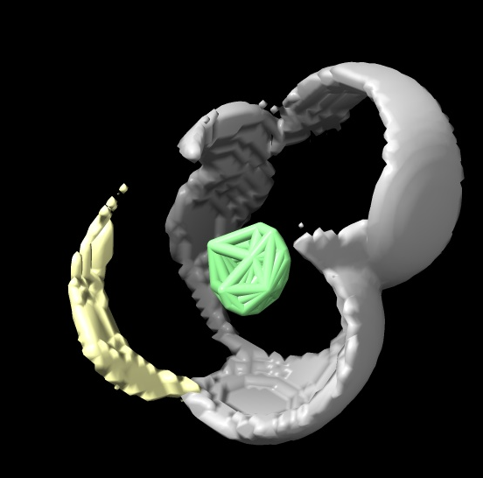
A
B

